Slide 1

Early Years
Information

Slide 2


Welcome to Bowerdean Nursery School
This presentation aims to provide an introduction to our Nursery and includes initial information which we hope you will find useful. Should you have any further questions, staff will be happy to discuss these with you.
We’re very proud of our Nursery and the opportunities we provide for the children to explore language, art, maths, science and the natural world. We love learning and our aim is to provide the best possible start to your child’s school journey.
You can also access this information on the school website.
The school website and social media channels are kept up to date with the latest news and events and have lots more information about our school.
www.bowerdean.bucks.sch.uk
Bowerdean Nursery School
BowerdeanNurserySchool

Slide 3




Who’s Who
Early Years Educators
Mrs Shahnaz Begum
Miss Nawal Elhoussaini
Mrs Saima Nazli
Mrs Shazia Parveen
Mrs Trina Richards
Mrs Janine Underwood
Mrs Karamat Yaqub
Headteacher – Mrs Zoë Staines
Teacher – Miss Amy White
SEN Teacher – Miss Wendy Yolland
Office Team
Mrs Anne Barefield
Miss Clare Mullan
Mrs Emily Chatterton

Slide 4


Daily Timetable
Daily Timetable:
Breakfast club: 0800 - 0845
Morning: 0845 – 1145
Lunch: 1145 – 1215
Afternoon: 1215-1515
Afterschool Care: 1515 – 1615
Important Dates: Important dates and events are included in our regular newsletters and can also be found on our school website.

Slide 5
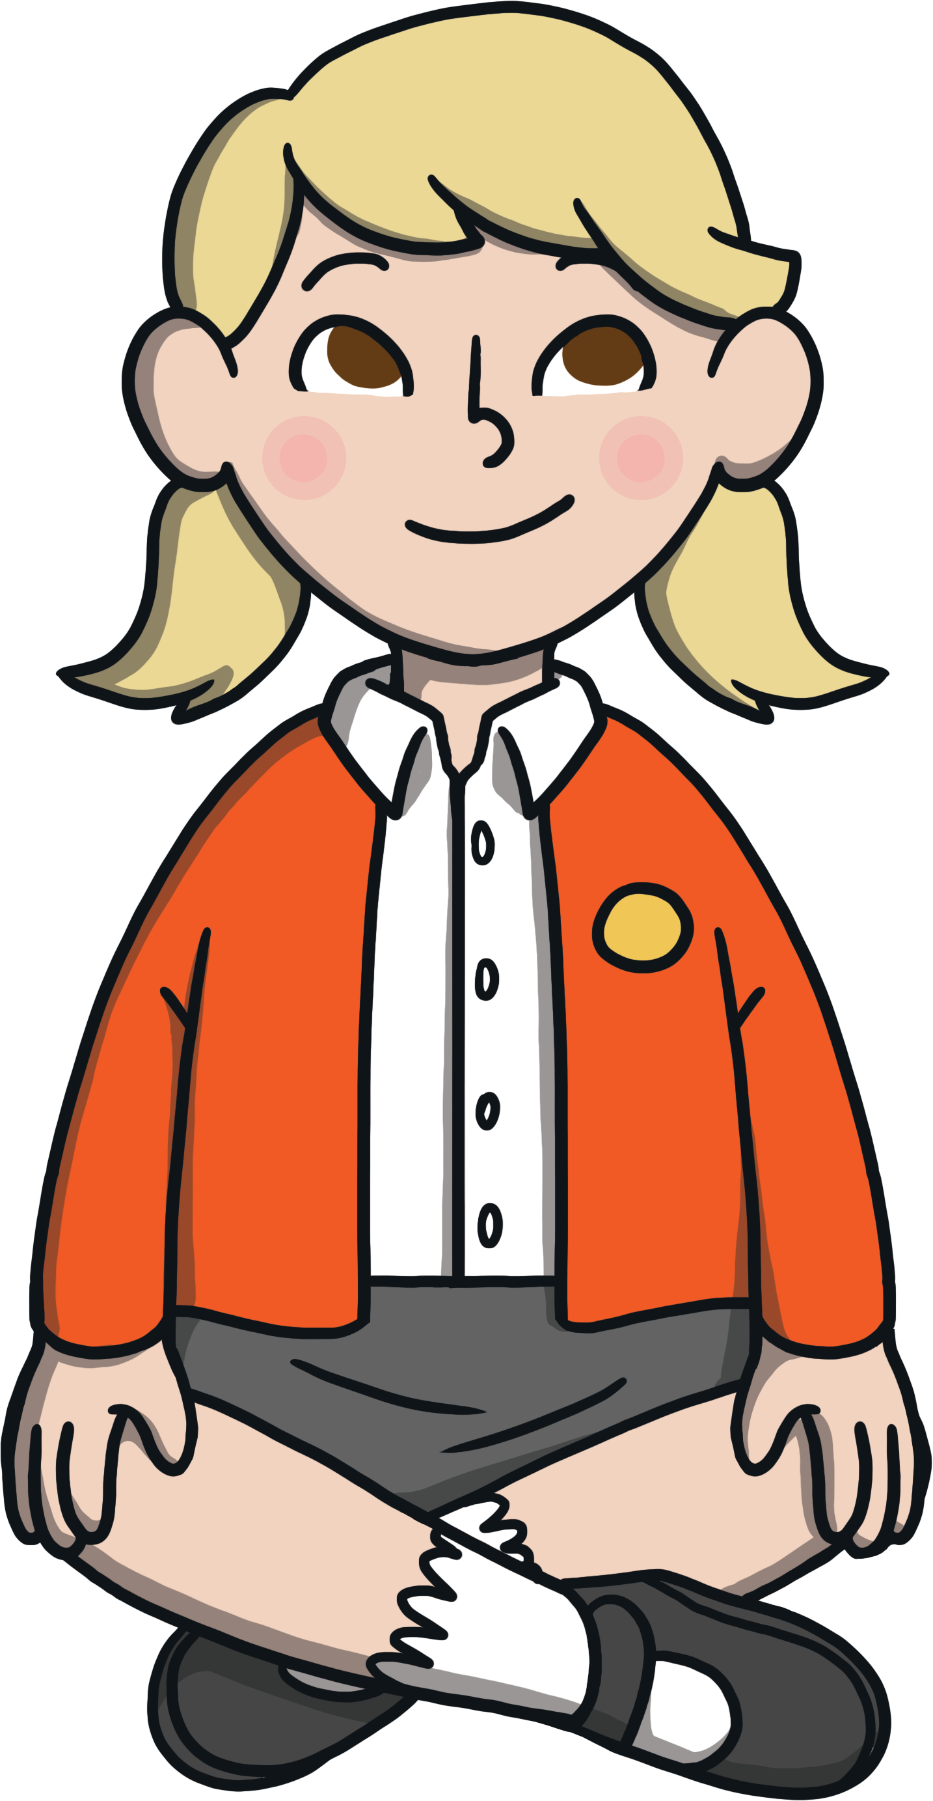

Clothing
Dress for mess, not to impress!
We get messy and dirty at Nursery. Please do not put your child in their best clothes.
Clothing should also be appropriate for the weather as children go outside everyday, whatever the weather.
Please ensure that all clothing that your child wears or brings into school, is clearly named.
It is useful to leave a named bag of spare clothes (named) at Nursery.
Nappies – please ensure you bring a named bag of suitable nappies and wipes, which can be left at Nursery for your child’s use.

Slide 6


Food and Drink
Lunch: At lunchtime your child can have a small packed lunch prepared at home and brought into school. Lunchtime is between 1145 – 1215
Packed lunches should support our school’s healthy eating policy. We can not heat up food. Please note that our school is a ‘nut free’ zone which means that all types of nuts are banned.
Breakfast club: cereal, toast, milk and water are available for those attending.
Snacks: Children have access to snacks throughout the day. This is normally fruit, vegetables, crackers, breadsticks, water and milk.
Please do not send your child with food or drink to Nursery, unless it is for their lunch. This is unnecessary as snack are available at all times and it also presents allergy risks.

Slide 7

Health
Health: Staff need to be aware of your child’s medical background, in particular any allergies (e.g. bee stings, dairy food), any dietary restrictions (e.g. vegetarian or Halal) and any medical conditions that are important for us to know (e.g. asthma or eczema).
Children can suddenly become ill and it is important that we can contact you or another adult relative/friend at all times. It is useful if your emergency contact lives near to school, so it may be more appropriate to choose a friend instead of a family member for us to contact if we cannot reach you.
Please ensure that the school is kept up to date with your contact details. If your child is unable to attend school due to illness, please telephone the school office to let us know.
Calpol – if your child has had calpol, they are not well enough to be at Nursery.
Outdoor play – if your child is not well enough to play outside, they are not well enough to be at Nursery.

Slide 8

Helping Us to Help Your Child
These are a few ways that you can help your child:
Ensure that all their belongings are named and they know what they look like!
Support us by following our expectations, e.g. Not asking your child to come back to get things they have forgotten.
Think about packaging in lunchboxes, for example, yoghurt tubes can be tricky to open. They also don’t need a 3 course meal!
Help them to be independent with their toileting skills.
Encourage them to sit and listen to stories.
Practise sharing and taking turns.
Please don’t allow your child to bring toys from home.

Slide 9

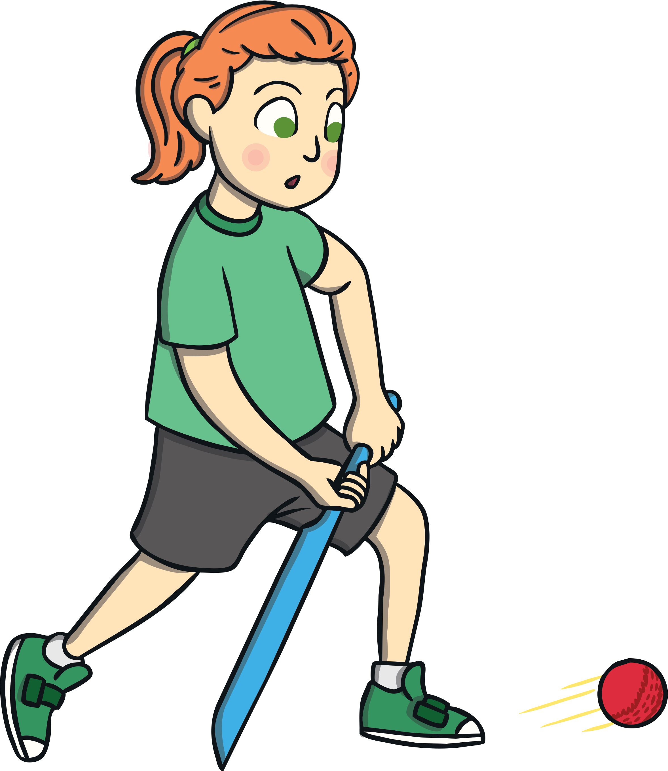
A Typical Day
Circle Time - this is adult-led learning time, in which the children are expected to sit, listen, think and share ideas.
Free-flow – children have access to a range of activities that support our learning theme or specific skill. They can also play, explore and create their own games. Adults support the children to play co-operatively, use their imaginations and develop their knowledge.
Snack is available throughout the free-flow session. Children access this independently when they wish.
Circle Time – this final part of the session includes singing and stories.
We are a school, rather than playgroup or day nursery.
Our Circle Time is widely recognised for enabling outstanding learning opportunities.
It’s vital that children are on time, as it is embarrassing for children coming in late to group time and it’s disruptive to class learning.

Slide 10
Early Years Curriculum
We aim to inspire and enable children so they can play an active role in their lives and fulfil their individual potential.
We embrace a fully cross-curricular approach to learning and our curriculum is developed around the seasons, providing a careful balance of adult-led teaching and play-based exploratory learning.
Our weekly planning is always based on books to develop listening skills, widen vocabulary and strengthen children’s imaginations.
There are 7 Areas of Learning in the Early Years Foundation Stage (EYFS), which activities are planned around:
Personal, Social and Emotional Development
Physical Development
Communication and Language
Literacy
Mathematics
Understanding the World
Expressive Arts and Design

Slide 11

Sharing Learning
Throughout the year, staff observe and monitor your child’s learning. We use these observations to plan ways to support their development.
We do not generally share photos of the children’s activities. This is because it is more important for staff to be talking to the children than taking photos. Also, we are aware that by sharing photos on apps, like ClassDojo, we are encouraging you to use mobile devices with your children.
We are unable to provide daily or weekly feedback for each child as this takes staff away from essential time talking and playing with the children to ensure their best possible progress.
We do dhare our planning on ClassDojo each week so you can talk to your child about what they have been doing. We also use ClassDojo to post reminders about things happening in Nursery. Please ensure you have registered with the app as this is our main method of communication.

Slide 12

Home Learning
80% of your child’s learning is done at home.
The support you provide at home is the most important factor in your child’s development. Your child’s educational journey is a partnership with school. The more support you give them, the more they will achieve.
Top tips to support learning at home:
Read a story every day
Talk to your child at every opportunity
Keep screen time to a minimum
Encourage independence
Allow your child to take risks
Follow a set routine

Slide 13

We hope that this presentation is useful.
Should you have any questions, please feel free to speak to a member of staff.
We look forward to working with both you and your children.

