Slide 1

Talking Tech
Why does technology use matter and how can we stay safe?

Slide 2
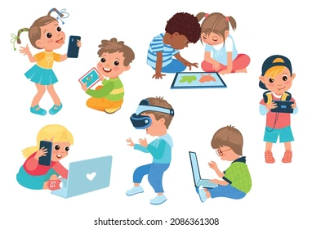
What do your children use?
How do they use it?
When do they use it?
What do you notice?

Slide 3
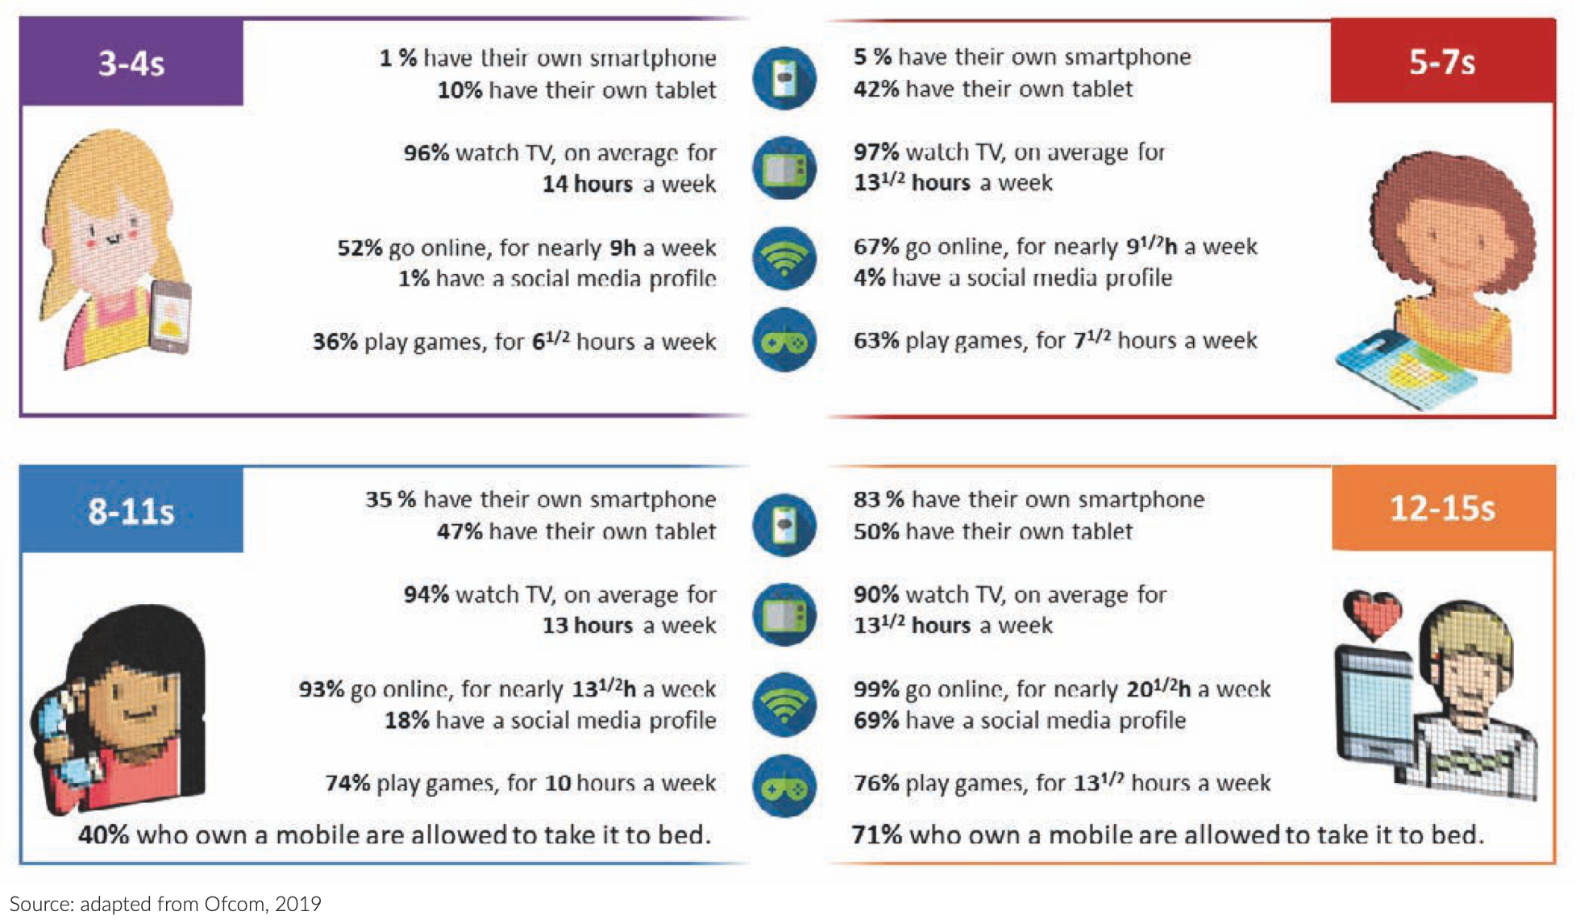
> 50% Nursery children online for nearly 9hs p/w
> 50% Nursery children are exposed to digital technology before books
2019 data – pre Covid
Notes:
Does anything surprise you? What do you feel about these data?
22% of parents of 3-4-year-olds don’t
think their child has a good balance
between screen time and other activities
* Source: Ofcom Children and parents: media use and attitudes report 2022

Slide 4
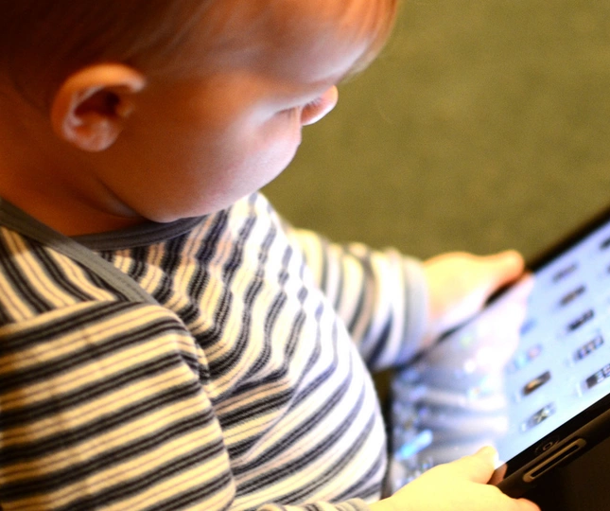
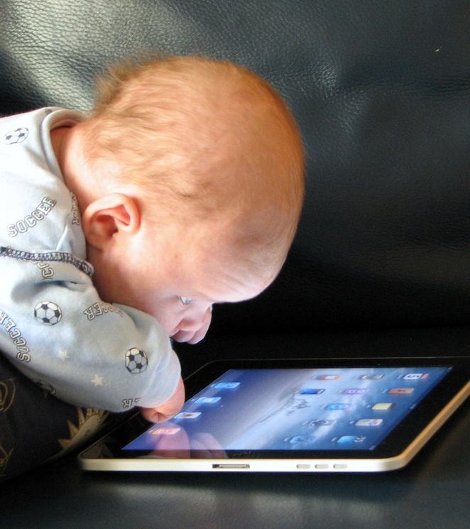
Why does it matter?
90% of brain development happens during the first 5 years of life.

Slide 5
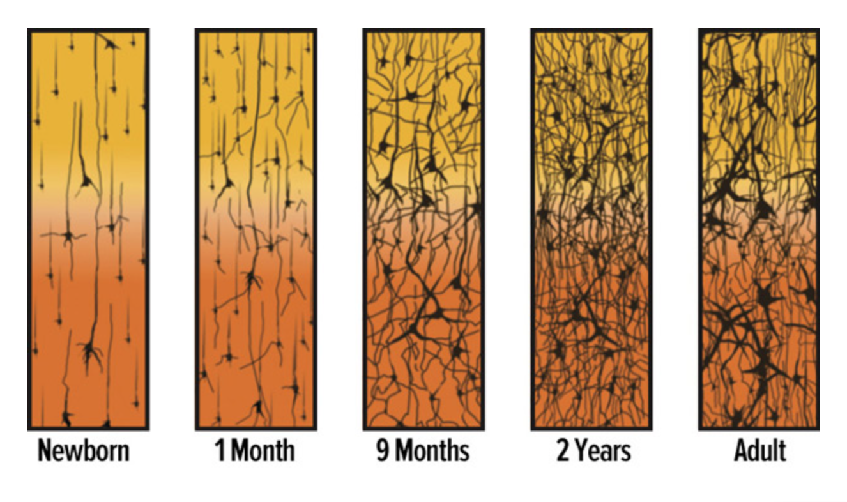

Babies’ brains are elastic.
We are born with embryonic brains that need to learn to make connections between sight, sound, touch.
These neural connections – synapses – build our brains.
The 1st 3 years are critical.
The brain triples in volume due to these synaptic connections.
It’s critical that the stimuli and challenges children experience in this time are the kinds of challenges that help them build creative, flexible and resilient brains.
Notes:
If we don’t use these connections or strengthen them through repetition and refinement, we lose them – they are pruned.
Compare to the adult synapses – bit like language learning or algebra – don’t use it, we lose it!
Screens have been shown to change the way these pathways are formed & also hinder development as interaction of all kinds (linguistic, physical, creative) are limited, so children don’t form the necessary pathways for typical development.

Slide 6
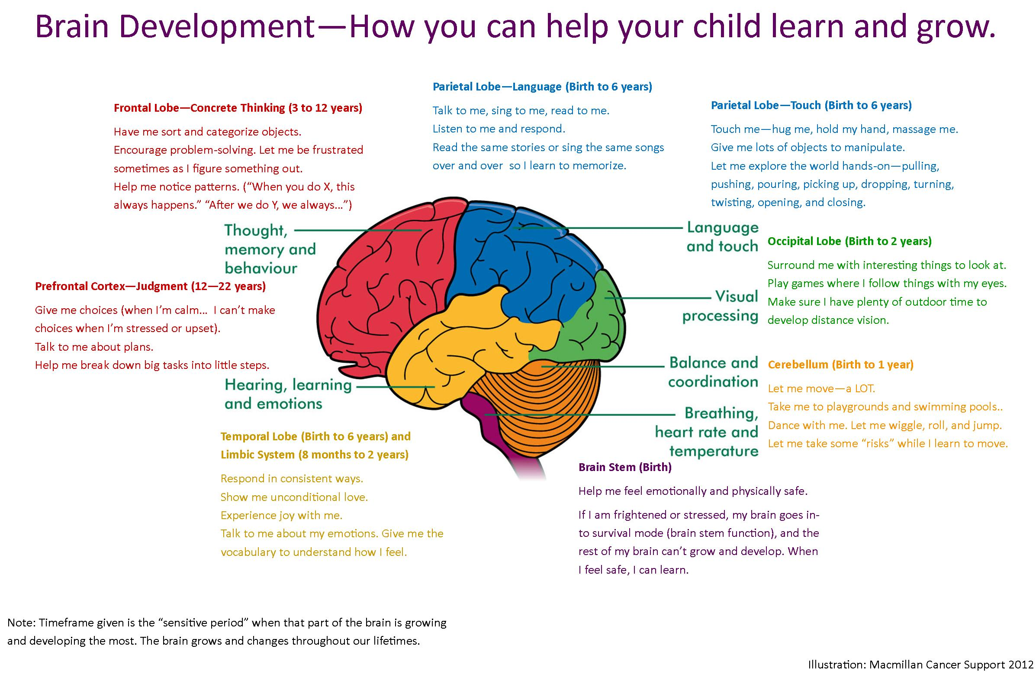
Notes:
Prefrontal cortex – recent research shows that in fact this also undergoes rapid growth during first 2 yrs. Adverse childhood experiences in infancy will significantly affect ‘risk taking management’ in teens.
Language learning - The first nine months of life are important for a child’s understanding of sounds and how they should be interpreted.
Children are often capable of understanding language long before they can actually speak it.
If we don’t speak to them, and all they hear are sounds from games/cartoons etc – that’s what they understand & tune in to - not human voice.
Screen time impacts language development – Harvard study showed children who spent more time on a screen instead of talking showed more than 12mth delay in expressive and receptive language development.
Supported by WHO 2019 research - increased screen time was associated with poorer motor and cognitive development and increased body weight

Slide 7
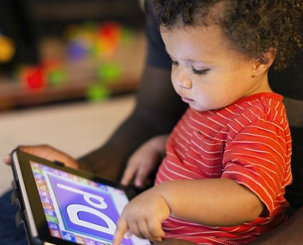

How much screen time?
What kind of screen time?
Social and verbal interaction is critical.
Face to face interaction is everything!
Research has shown very young children can begin to understand language through video calling – but only if they have heard or seen the person in real life.
WHO recommends:
NO screen usage (even tv) for under 2s.
Less than 1 hour for 3-4 yr olds.
Notes:
Screen time
Not necessarily use of technology but type & the interactivity that occurs.
Face to face interaction is everything – it includes facial response, signs, gestures – much more meaningful and helps children begin to understand social cues and how to form human connections – family relationships / friendships etc.

Slide 8
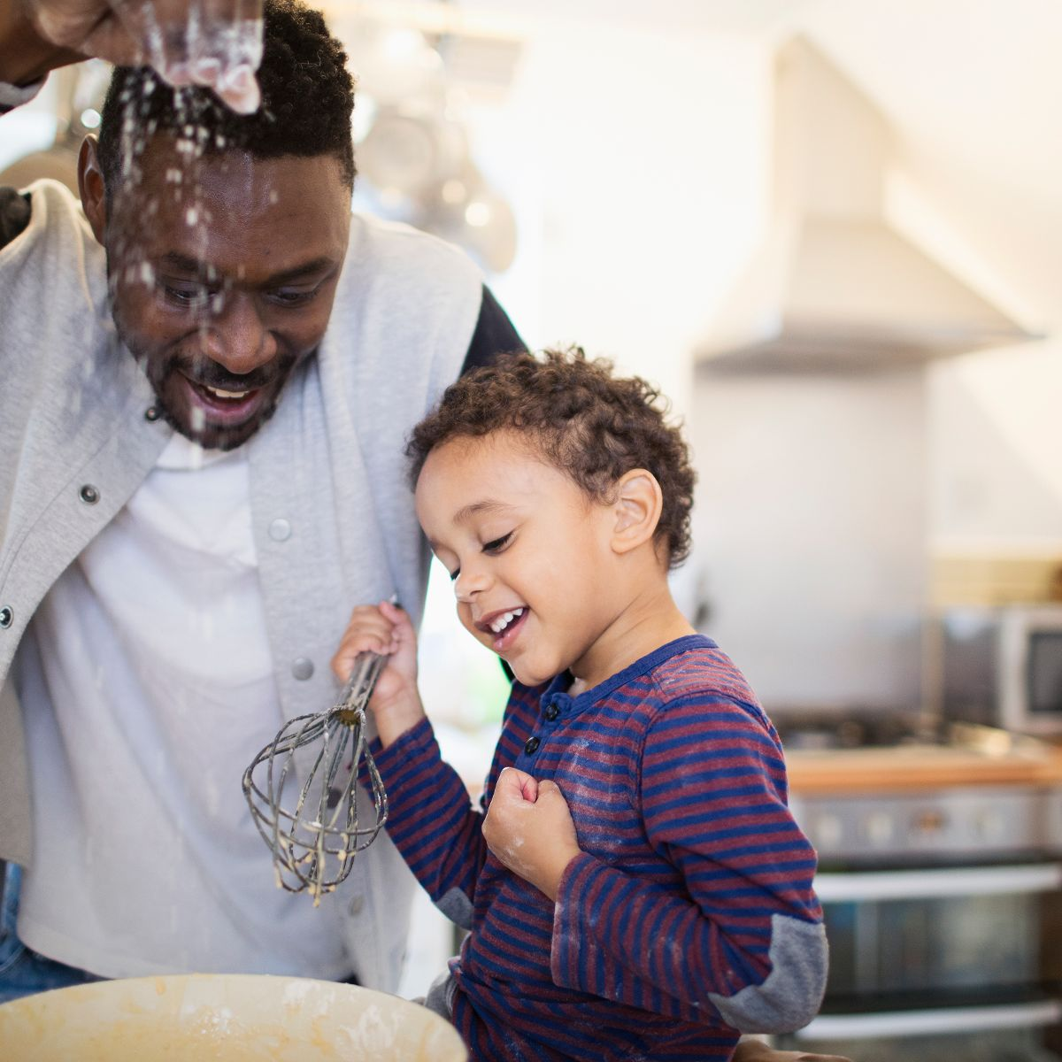


When can technology use have a negative impact?
When it replaces something that could be far more beneficial to development.
Notes:
When do we use it negatively?
Instead of getting chn to help – used as a diversionary tactic – a babysitter. This is the most detrimental.
Helping to cook, clean, sort the washing, unpack shopping are all highly valuable experiences.

Slide 9

How to use technology positively?
1. Take the opportunity to talk with
your child
2. Use screen time to physically
interact
3. Limit your own screen time
4. Limit screen use to video calling
interaction
5. No screens at least 1 hr before bed
6. Don’t use screens to comfort or help
your child regulate their behaviour
7. Screen free mealtimes
8. Monitor and control access to
devices/content
Notes:
How to use technology positively?
Take the opportunity to talk with your child – that’s what we do here.
Even babies who aren’t yet talking can understand and learn many of the words you’re using and your tone of voice.
Ask questions about what they think the characters are feeling or how might react if they were in the story.
2. Use screen time to physically interact – sit with them on your knee or next to them
3. Limit your own screen time – practice what you preach! Model what we want our children to do
4. Limit use to video calling interaction – to make meaningful connections
5. No screens at least 1 hr before bed
6. Don’t use screens to comfort or help your child regulate their behaviour
7. Screen free mealtimes
8. Monitor and control access to devices/content – parent settings / sibling usage / E-safety advice on school website

Slide 10

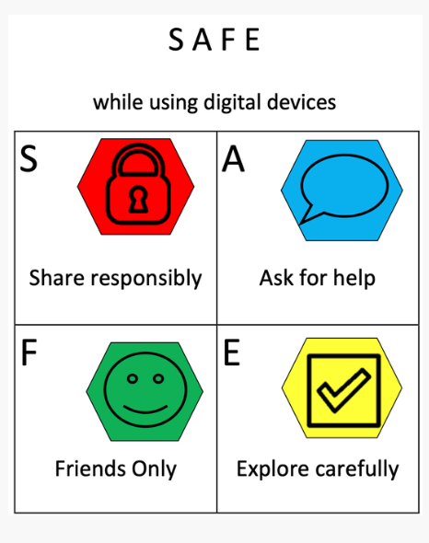
Technology In Early Childhood Studies:
WHO Guidance
Unicef Guidance
OECD - What we know about children and technology
Boston Children's Hospital - Digital Wellness
Internet Safety:
Bowerdean Nursery: E Safety
Internet Matters: Internet Matters Age Guide 0-5s
Notes:
Boston Children’s Hospital – https://digitalwellnesslab.org/parents/family-digital-wellness-guide/birth-preschool/
Dr Michael Rich – Harvard paediatrician – 250% increase in children 6-24 needing help with problematic technology use.
Bowerdean Nursery - https://www.bowerdean.bucks.sch.uk/e-safety/
Internet Matters: https://www.internetmatters.org/wp-content/uploads/2023/01/Internet-Matters-Age-Guide-0-5s-Jan23.pdf
OECD - https://www.oecd.org/education/ceri/Booklet-21st-century-children.pdf
WHO - https://www.who.int/news/item/24-04-2019-to-grow-up-healthy-children-need-to-sit-less-and-play-more
Unicef - https://gdc.unicef.org/resource/digital-guidelines-promoting-healthy-technology-use-children

